Slide 1

Testing of e-Pariksha Platform
Analyse Your Knowledge
Manual & Automation
Vivek Tiwari
2509401147009
Manual & Automation
Tilak Shelke
2509401147007
Project Guide :
Ms. Gita Gosavi
Manual & JMeter
Manoj Ambhore
2509401147002
Manual & JMeter
Vishvjeet Singh Chauhan
2509401147008

Slide 2
Introduction:
The e-Pariksha Portal is a comprehensive, web-based examination management system developed by C-DAC Pune.
It facilitates secure question bank management, real-time exam monitoring, and instant automated evaluation for large-scale candidate batches.
By integrating advanced data encryption and shuffling algorithms, the portal ensures a transparent, cheat-proof, and highly scalable environment for both academic and professional assessments( Link)

Slide 3
Project Implementation Window:
Project Start Date: 19 January 2026
Project End Date: 05 February 2026
Project Duration: 17 days

Slide 4
Scope:
Manual functional testing for all user roles
Automation testing using Selenium WebDriver with Java
Smoke testing
Regression testing
Role-based access and authorization validation
End-to-end examination workflow testing
Cross-browser testing on local browsers (Chrome, Firefox)
Performance testing (basic response time and stability checks)
Security testing (basic authentication and authorization validation)

Slide 5
Roles & Responsibilities
Roles | Members | Responsibilities
1. Admin | Manoj Ambhore | Manual & Automation Testing for Admin User, course, examiner, Performance Testing JMeter
2. Examiner | Tilak Shelke | Manual & Automation execution for examiner workflow validation , Bug Reporting
3. Examiner | Vivek Tiwari | Test planning, coordination, automation framework design, Manual & Automation Execution and reporting.
4. Student | Vishvjeet Singh Chauhan | Manual Testing for Candidate-side exam execution and validation, Performance Testing JMeter

Slide 6
Application Workflow:
Upload Student to Respective Course
Create Examiner
Create Course & Modules
Course Assign to Examiner
Upload Question & Schedule the Exam
Candidates takes the Exam
Examiner view the Result
Generate Reports

Slide 7
STLC Phase Wise:
STLC Phase | Activities | Dates | Deliverable
Requirement | Application Workflow | 19-01-2026—20-01-2026 | Link
Planning | 2. Test Plan, Strategies | 20-01-2026—21-01-2026 | Link
Test case Development | 3. Test Scenarios & Test Cases Design | 21-01-2026—24-01-2026 | Link
Test Env. Set-up | 4. Framework Created | 24-01-2026—25-01-2026 | Link
Test Execution | 5. Bug Reporting | 25-01-2026—28-01-2026 | Link
Test Cycle Closure | 9. Test Closure Report (Manual + Automation) | 5 February 2026 | Link

Slide 8
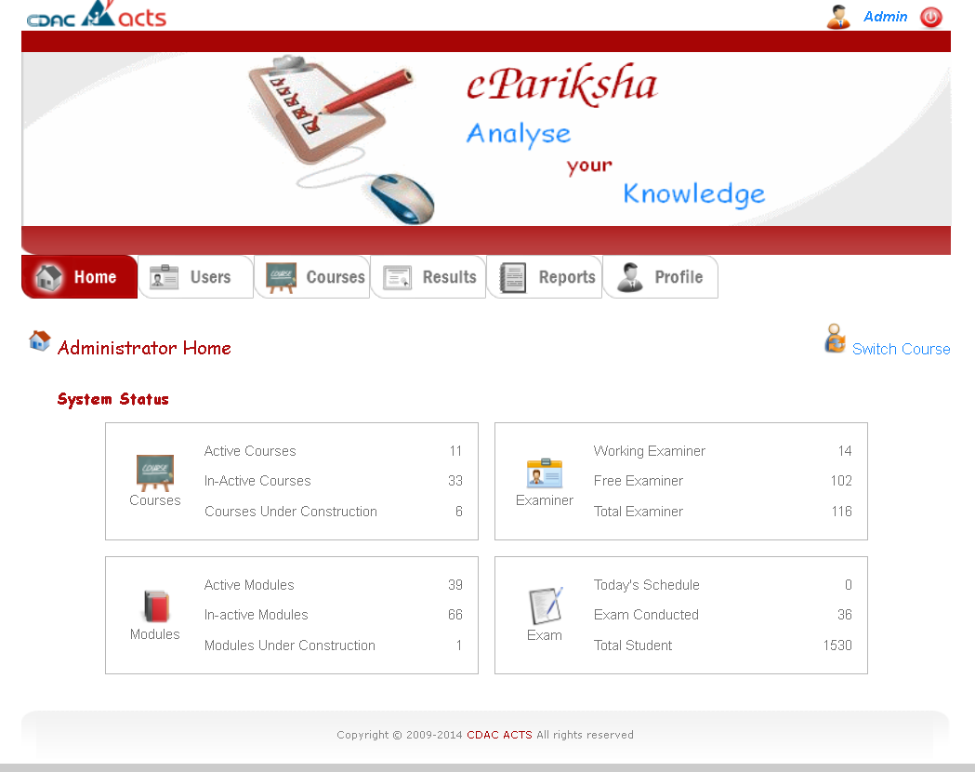



Admin Role:
Pass Test Cases: 240
Failed Test Cases: 05
Total Test Cases: 245
Critical :05
High:00
Medium :01
Low:00
Total Bug:05
Test Cases Created By : Manoj Ambhore

Slide 9
Admin flow detailed Bugs:
1. Bug_Id : A_BG_01 - Once Switch Role Unable to Return Back .
2. Bug_Id : A_BG_02 - Error message is not display when space
is given in admin valid userid field
3. Bug_Id : A_BG_03 - Error message is not display when space
is given in admin valid password field
4. Bug_Id : A_BG_04 - an error message is not displayed when an space in valid userid and a space in valid password are entered.
5. Bug_Id : A_BG_05 - No Minimum Age Validation for CC User.
Tested By : Vishvjeet Singh Chauhan

Slide 10
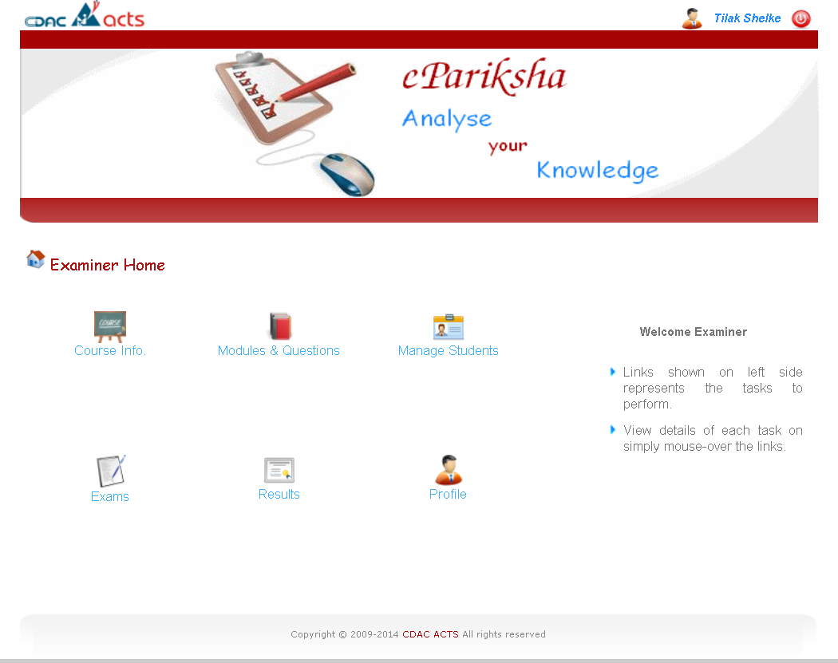
Examiner Role:
Pass Test Cases: 341
Failed Test Cases:11
Total Test Cases: 352
Critical :05
High:01
Medium :02
Low:03
Total Bug:11
Test Cases Created By : Tilak Shelke & Vivek Tiwari

Slide 11
Examiner flow detailed Bugs:
1. Bug_Id : C_BG_01 - Absence Of Captcha Functionality in Login Page.
2. Bug_Id : C_BG_02 - CDAC ACTS Logo failed to Navigate.
3. Bug_Id : C_BG_03 - Read More Navigate to the Wrong Page .
4. Bug_Id : C_BG_04 - Back Navigation Arrow Not Working .
5. Bug_Id : C_BG_05 - Exam Date Schedule Exam After Course End
Tested By : Vishvjeet Singh Chauhan
Tested By : Vivek Tiwari
Tested By : Vivek Tiwari
Tested By : Manoj Tiwari
Tested By : Vivek Tiwari

Slide 12
Examiner flow detailed Bugs:
6. Bug_Id : C_BG_06 - after CC login CC can Access the Admin Page by Admin url
7. Bug_Id : C_BG_07 - It Accept any time when cc Trying to Schedule the Exam.
8. Bug_Id : C_BG_08 - It Accept as Zero as Passing Marks for Exam
9. Bug_Id : C_BG_09 - There is no restriction on the number of incorrect password attempts.
10. Bug_Id : C_BG_10- When we change the CC password CC still in Same Page
11. Bug_Id : C_BG_11- Random Password change for Selected Student
Tested By : Vivek Tiwari
Tested By : Vishvjeet Singh Chauhan
Tested By : Manoj Ambhore
Tested By : Vivek Tiwari
Tested By : Vishvjeet Singh Chauhan
Tested By : Vishvjeet Singh Chauhan

Slide 13
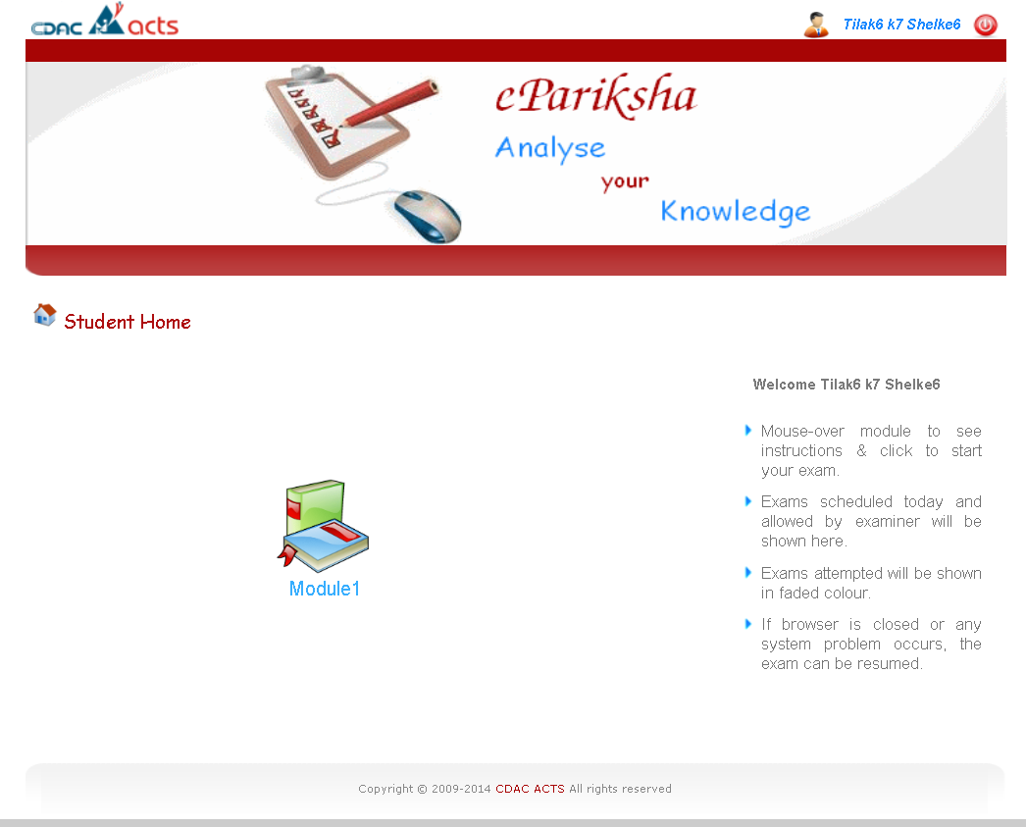
Student Role:
Pass Test Cases: 55
Failed Test Cases: 06
Total Test Cases: 61
Critical :02
High:01
Medium :00
Low:03
Total Bug:06
Test Cases Created By : Vishvjeet Singh Chauhan

Slide 14
Student flow detailed Bugs:
1. Bug_Id : S_BG_01 - CDAC ACTS Logo Navigation happen during exam.
2. Bug_Id : S_BG_02 - Window Switching Message.
3. Bug_Id : S_BG_03 - Tab Closed After Student Login, Student block .
4. Bug_Id : S_BG_04 - Warning didn’t display before 5 min Of Exam end .
5. Bug_Id : S_BG_05 - Student Access the Admin Tab by admin url.
6. Bug_Id : S_BG_06 - Blocked Account Login
Tested By : Tilak Shelke
Tested By : Tilak Shelke
Tested By : Manoj Ambhore
Tested By : Vivek Tiwari
Tested By : Tilak Shelke
Tested By : Tilak Shelke

Slide 15
Manual Testing Report (Link):
Pass Test Cases: 635
Failed Test Cases: 022
Total Test Cases: 658

Slide 16
●Automation Testing in e-Pariksha
○e-Pariksha is a role-based examination system involving Admin,
Coordinator, and Student.
○Automation testing is implemented to validate critical and repetitive
exam workflows.
○Selenium automation helps ensure Faster regression execution, Accurate
role-based validation, Stable exam readiness.
●Goal of Automation:
○Reduce manual effort
○Improve execution speed
○Increase confidence before exam conduction

Slide 17
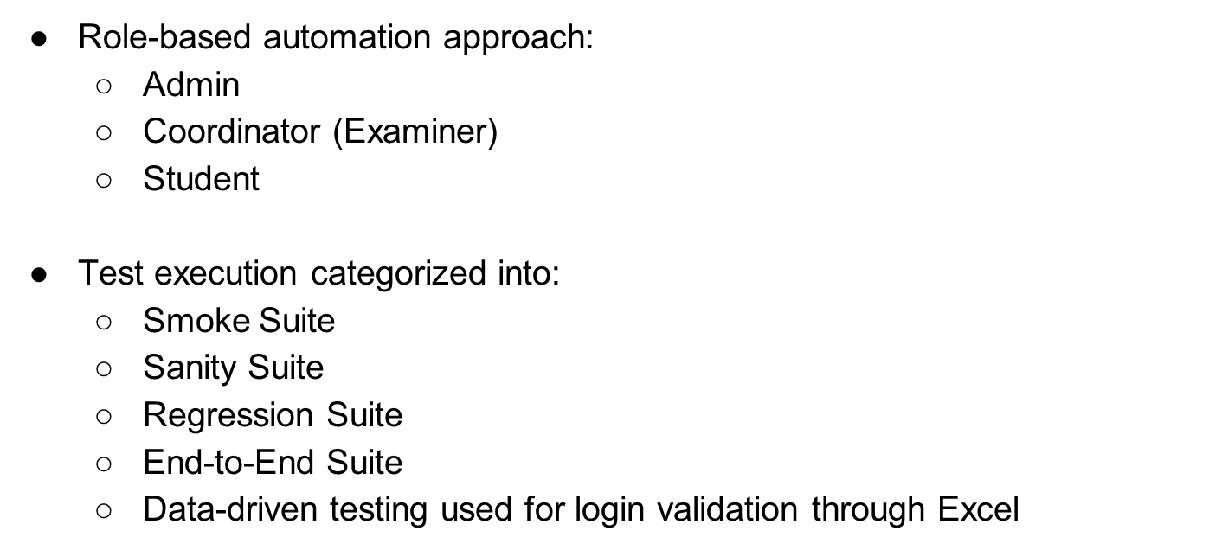

Slide 18
Tools & Technologies:
Category | Tool
Automation Tool | Selenium WebDriver
Programming Language | Java
Test Framework | TestNG
IDE | Eclipse IDE
Test Case Management | Excel
Defect Tracking | Excel
Version Control | Github

Slide 19
Why These Tools & Technologies :
Test Case Management (Excel):
Excel was utilized for maintaining and organizing test cases due to its simplicity, ease of customization, and suitability for small to medium-scale projects.
Defect Tracking (Excel):
Excel was used for defect tracking to record, monitor, and analyze defects effectively, ensuring clear communication and traceability within the team.
Version Control (GitHub):
GitHub was adopted for source code management to enable version control, team collaboration, secure code storage, and maintenance of change history.
Automation Tool (Selenium WebDriver):
its open-source nature, strong community support, and capability to automate web applications across multiple browsers efficiently.
Programming Language (Java):
Java was used for automation scripting because of its platform independence, robustness, and excellent integration with Selenium and testing frameworks.
Test Framework (TestNG):
TestNG was implemented to manage test execution, support annotations, enable parallel testing, and generate detailed execution reports.
Integrated Development Environment (Eclipse IDE):
Eclipse IDE was chosen for its powerful development features, seamless Java support, efficient debugging capabilities, and wide plugin availability.

Slide 20
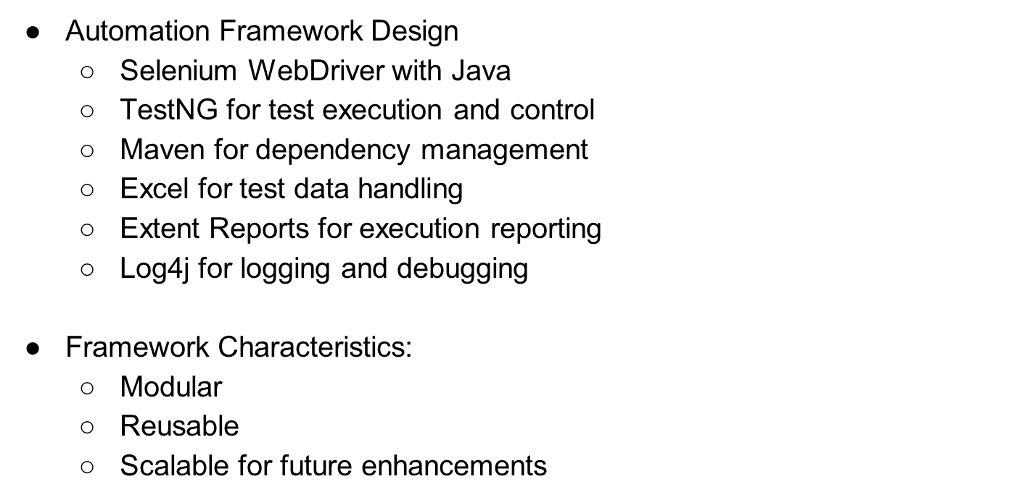

Slide 21
Automation Critical Workflow :
Admin Login
Create Examiner
Create Courses
Added Modules in Courses
Courses Assign to Examiner
Examiner login
Examiner Change the Password
Question File Upload
Student List Upload
Exam Schedule
Examiner Logout
Student Login
Attempt Login
Student View the Result
Student Logout
Again Examiner Login
Examiner View the Result
Examiner Logout
Performed By : Vivek Tiwari and Tilak Shelke

Slide 22

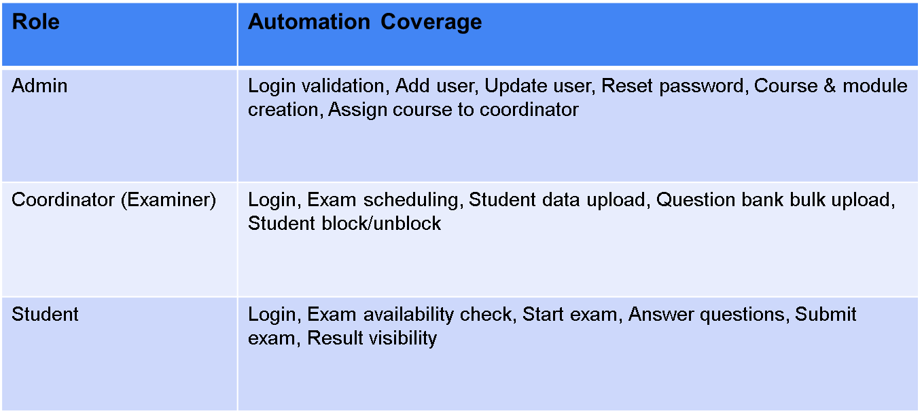

Slide 23
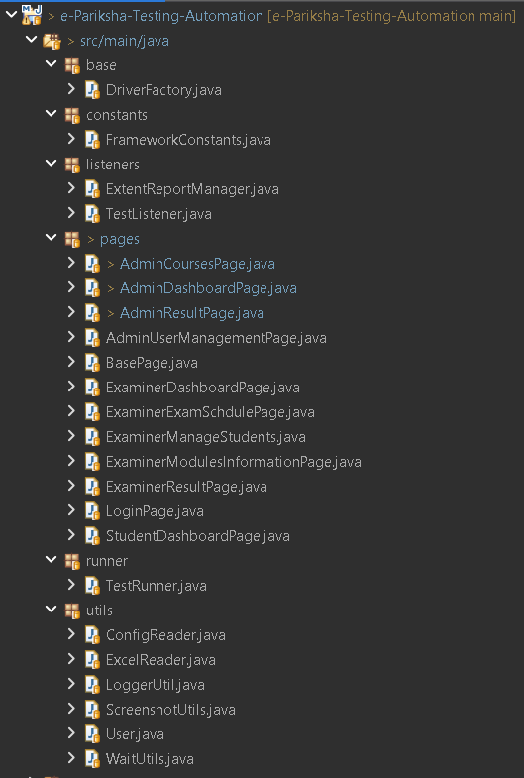
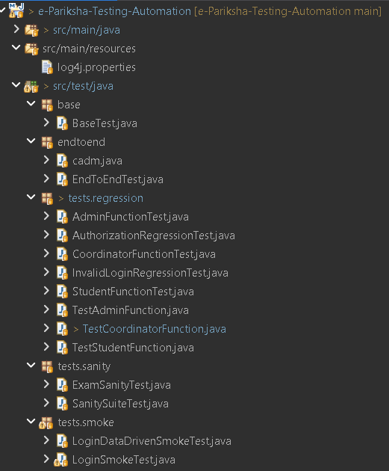
Project folder Structure:
1.
2.

Slide 24
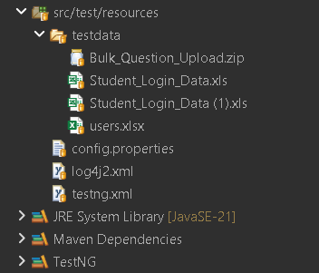
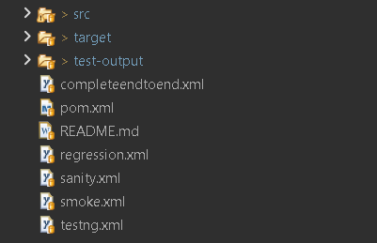
Project folder Structure:
3.
4.

Slide 25
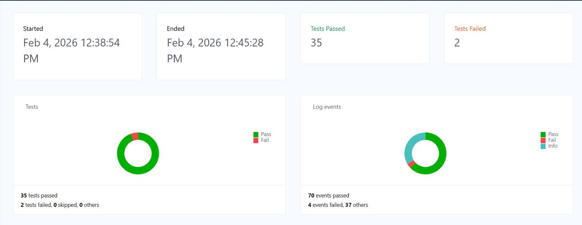
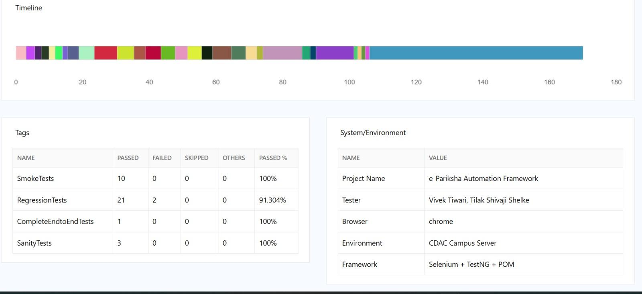
Automation Testing Report (Extend_Report):
Created By : Vivek Tiwari & Tilak Shelke

Slide 26
Suggestions:
For All user→ Remember me functionality Should be Available
For All user → Forgot Password functionality Should be Available
Exam → Delete,edit ,Add button Should be Available for Exam .
Student → Delete,edit ,Add button Should be Available for Student.
Suggestion By :Team

Slide 27
Thank You!
Questions?

Slide 28
References:
http://ccst-testvm.pune.cdac.in:8080/epAdmin/index.jsp
https://cdac.in/index.aspx?id=Acts
https://drive.google.com/drive/folders/1_iNl-4iROLBPkRTfQrWzGzkf71eV8tmS?usp=drive_link

